Slide 1


Slide 2
1
The Ask – Where we started?
Beginners in software development, aiming to enhance our skills in UML, Java, MySQL, and web integration for real-world applications.

Slide 3
Framework for 6 Days
6 Days plan
Every Day Discussion about Topics/ Technologies/ Doubt clearance .
Everyday with SME/Trainer discussion of Project progress & Transformation based on UML & Technologies

Slide 4
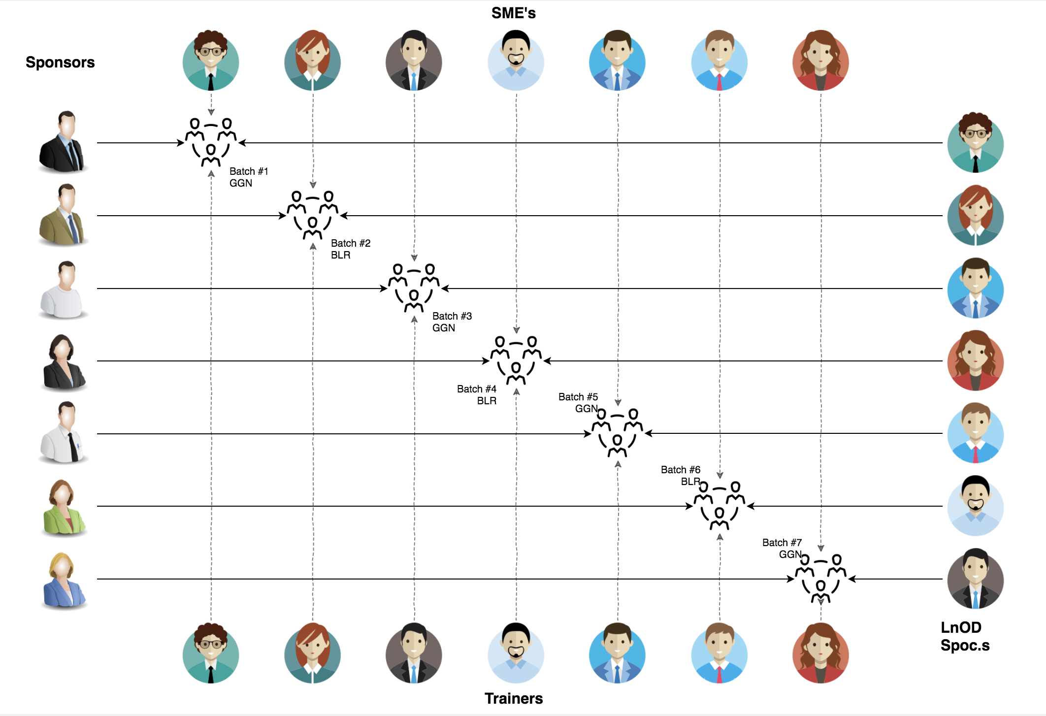
Stakeholders
Sponsors
Flipkart
SME’s
Amit Balyan
Other HRs & Experts
Trainers
Trainers
Assess
Course-Corrections

Slide 5
Our next starts
NOW
Notes:
Time – 1 min
Swati

Slide 6
6 DAYS OF TRAINING + PROJECT DEMO
6 DAYS
144 HOURS
8,640 MINUTES
5,18,400 SECONDS
LIMITLESS KNOWLEDGE

Slide 7

Agenda
01
Our Journey
02
Our Team
03
Project Goals
04
Engineering Practices
05
Tech Stack
06
Development
07
Challenges & Learnings
08
Demo
09
Questions
Notes:
Time – 1 min

Slide 8

Our Journey
Notes:
Time - 2 mins

Slide 9
Demo
Mindset
Process
5
Project Demo
Tools
4
Adapting to a
Developer Mindset
Comprehend
3
Design Thinking
2
Decide the Technologies JAVA/REST
1
Understanding Project Goals

Slide 10

Our Team
Notes:
Time – 2 mins

Slide 11



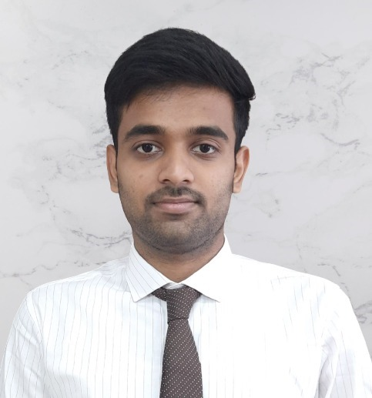
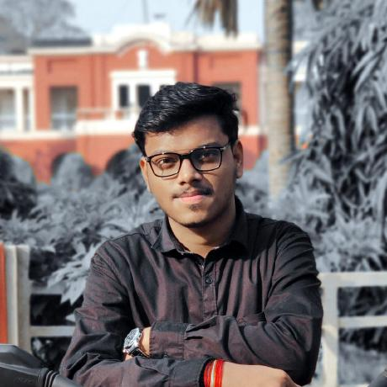
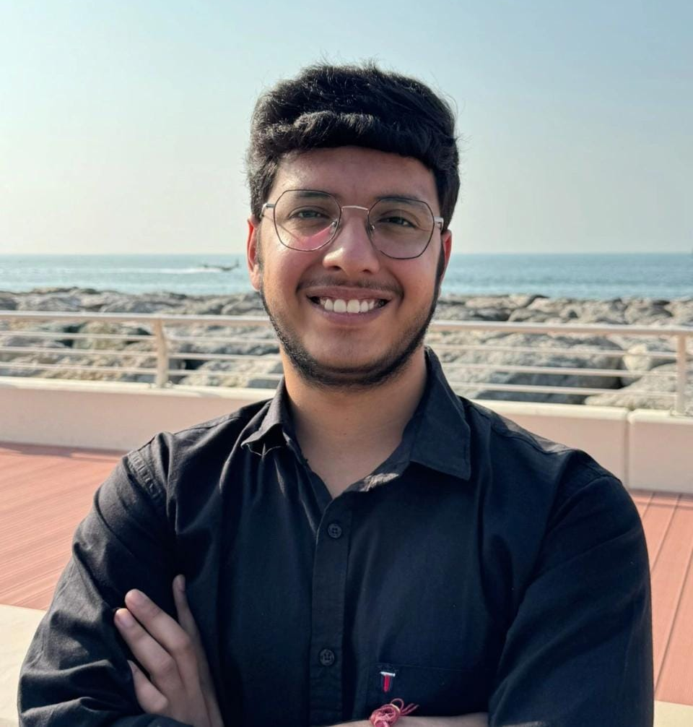
Somya
Rupashree
Surbhi Sharma
Sahas
Aman Harsh
Sarthak Vats

Slide 12

Project Goals
Notes:
Time – 3 mins

Slide 13




Our Vision
To develop a comprehensive FlipFit Gym Management System using full-stack development tools and technologies, enabling both agents and customers to seamlessly manage and access various gym services and products.
1
2
3
4
Quality
Security
Interactivity
Speed
Notes:
User satisfaction and brand value

Slide 14

Engineering Practices
Notes:
Time – 5 mins

Slide 15


Slide 16
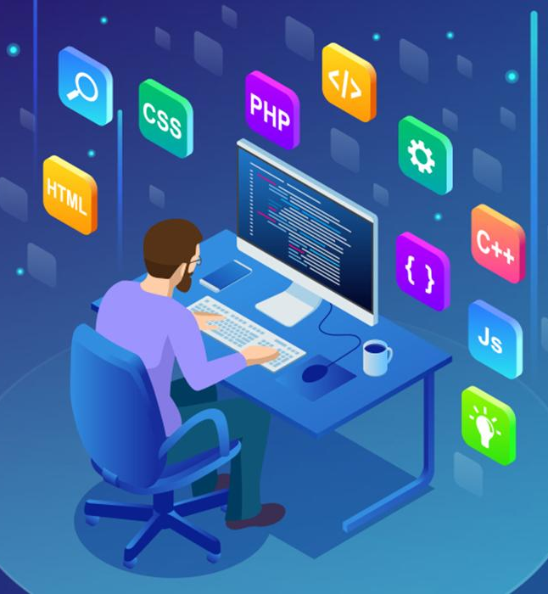
Tech Stack
Notes:
Time – 2 mins

Slide 17






Backend
Data
Tools
Core Language
SQL Database
API Client
IDE
Framework
SCM
Notes:
Time – 1 min

Slide 18

Development
Notes:
Time – 1 min

Slide 19
Establish clear objectives
Estimate time required for tasks
Requirement understanding
Research and analysis
Estimation
Sprint Planning
Sprint Grooming
Delivery
Sprint Implementation
LLD
Development
Code Review
Commit
Integrate
Deploy
Test
Notes:
Time – 1 min

Slide 20

Challenges & Learnings
Notes:
Time – 2 mins

Slide 21
Challenges
01
Coordination and Communication
02
Integration of Different Modules
03
Testing and Debugging
Learnings
01
Team Collaboration and Effective Communication
02
Tech Stack: Git, Java, MySQL, DropWizard, Postman
03
Industrial Development Practices
04
Problem-Solving and Debugging

Slide 22

Demo
Notes:
Time –
Architecture – 5 mins
NFR Dashboard – 3 mins
Demo – 10 mins
1. Show the Responsiveness and Wave tool first

Slide 23

Questions
Notes:
Time - ?

Slide 24
Thank you
Notes:
Time – After this show the testimonial video. 1 min

